Slide 1
AI: Agent
SK Ghosh
1

Slide 2
Agents
An agent is anything that can be viewed as perceiving its environment through sensors and acting upon that environment through actuators
Human agent: eyes, ears, and other organs for sensors; hands,legs, mouth, and other body parts for actuators
Robotic agent: cameras and infrared range finders for sensors; various motors for actuators

Slide 3

Agents and environments
The agent function maps from percept histories to actions: [f: P* → A]
The agent program runs on the physical architecture to produce f
agent = architecture + program

Slide 4

Vacuum-cleaner world
Percepts: location and contents, e.g., [A,Dirty]
Actions: Left, Right, Suck, NoOp

Slide 5
Rational agents
An agent should strive to "do the right thing", based on what it can perceive and the actions it can perform. The right action is the one that will cause the agent to be most successful
Performance measure: An objective criterion for success of an agent's behavior
E.g., performance measure of a vacuum-cleaner agent could be amount of dirt cleaned up, amount of time taken, amount of electricity consumed, amount of noise generated, etc.

Slide 6
Rational agents
Rational Agent: For each possible percept sequence, a rational agent should select an action that is expected to maximize its performance measure, given the evidence provided by the percept sequence and whatever built-in knowledge the agent has.

Slide 7
Rational agents
Rationality is distinct from omniscience (all-knowing with infinite knowledge)
Agents can perform actions in order to modify future percepts so as to obtain useful information (information gathering, exploration)
An agent is autonomous if its behavior is determined by its own experience (with ability to learn and adapt)

Slide 8
PEAS
Must first specify the setting for intelligent agent design
Consider, e.g., the task of designing an automated taxi driver:
  Performance measure: Safe, fast, legal, comfortable trip, maximize profits
  Environment: Roads, other traffic, pedestrians, customers
  Actuators: Steering wheel, accelerator, brake, signal, horn
  Sensors: Cameras, sonar, speedometer, GPS, odometer, engine sensors, keyboard

Slide 9
PEAS
Agent: Medical diagnosis system
Performance measure: Healthy patient, minimize costs, lawsuits
Environment: Patient, hospital, staff
Actuators: Screen display (questions, tests, diagnoses, treatments, referrals)
Sensors: Keyboard (entry of symptoms, findings, patient's answers)

Slide 10
PEAS
Agent: Part-picking robot
Performance measure: Percentage of parts in correct bins
Environment: Conveyor belt with parts, bins
Actuators: Jointed arm and hand
Sensors: Camera, joint angle sensors

Slide 11
PEAS
Agent: Interactive English tutor
Performance measure: Maximize student's score on test
Environment: Set of students
Actuators: Screen display (exercises, suggestions, corrections)
Sensors: Keyboard

Slide 12
Representation
A farmer wants to move himself, a hungry silver fox, a hungry, fat goose, and a sack of tasty grain across a river. Unfortunately, his boat is so tiny he can move only one of his possessions across on any trip. What is he to do?

Slide 13
Grain
Fox
Farmer
Goose
Farmer
Goose
Grain
Fox
Farmer
Fox
Goose
Grain
Fox
Grain
Farmer
Goose
Farmer
Fox
Grain
Goose
Goose
Farmer
Fox
Grain
Farmer
Goose
Fox
Grain
Farmer
Goose
Fox
Grain
Fox
Farmer
Goose
Grain
Farmer
Fox
Goose
Grain

Slide 14
Representation
Look at the representation in the figure above.
Graph like representation
Nodes: A safe distribution of entities on both banks of the river
Edges: connect nodes separated by a single boat trip
Solution: draw a line from start state to end state

Slide 15
Analysis
How many nodes?
How many safe nodes?
How many links?
How many legal links?

Slide 16
Representation is key
Node/Link representation is good
Once represented using nodes and links, problem is simple to solve

Slide 17
Representation
A lexical part: What symbols are allowed in your vocabulary/lexicon
A structural part: constraints on how symbols can be arranged
A procedural part: access procedures to create, modify descriptions
A semantic part: associates meaning with description

Slide 18
Semantic Nets
Lexical: Nodes, links, and app-specific link labels
Structural: Each link connects a tail node to a head node
Semantic: Nodes and links denote application specific entities
Procedural: node, link constructors, readers/visitors to traverse the net

Slide 19
Problem Solving
Since search forms the core of many intelligent processes, it is useful to structure AI programs in a way that facilitates describing the search process.
Production System:
It provides such structures. Production System is a formation for structuring AI programs which facilitates describing search process.

Slide 20
Production System consists of
  Initial or start state of the problem
  Final state of the problem
  One or more databases that contain whatever information is appropriate for the particular task.
  Set of production rules, each consisting of a left side that determines the applicability of the rule and a right side that describes the action to be performed if the rule is applied.
  Control Strategies
One of the examples of Production Systems is an Expert System.

Slide 21
Elements of Production Systems
Representation :
  State Space.
  Goal States.
  Initial States.
  Transformation Rules.
  Control Strategies

Slide 22
Production
DATA ← initial database.
Until DATA satisfies termination condition do:
begin:
  Select some rule, R, in the set of rules that can be applied to DATA.
  DATA ← result of applying R to DATA.
end.

Slide 23
Problem Description
Define State Space containing all possible configurations of relevant objects.
Specify some states as initial states.
Specify some states as goal states.
Specify Rules
Define the control strategies

Slide 24
Costs of Production System
Total Cost
Cost
Rules
Control
Level of “Informedness”

Slide 25
Search Through State-Space
Goal state
Initial state

Slide 26
Control Strategy
Forward Reasoning (Chaining): Control strategy that starts with known facts and works towards a conclusion.
Backward reasoning (Chaining): It is a goal directed control strategy that begins with the final goal. Continue to work backward, generating more sub goals that must also be satisfied until all the sub goals have been met.
Bidirectional reasoning

Slide 27
8-puzzle problem
State description (S)
  Location of each of the eight tiles (and the blank)
Start state (s)
  The starting configuration (given)
Operators (O)
  Four operators, for moving the blank left, right, up or down
Goals (G)
  One or more goal configurations (given)

Slide 28
Control
Rules
DATA

Slide 29

Knowledge in Production System

Slide 30
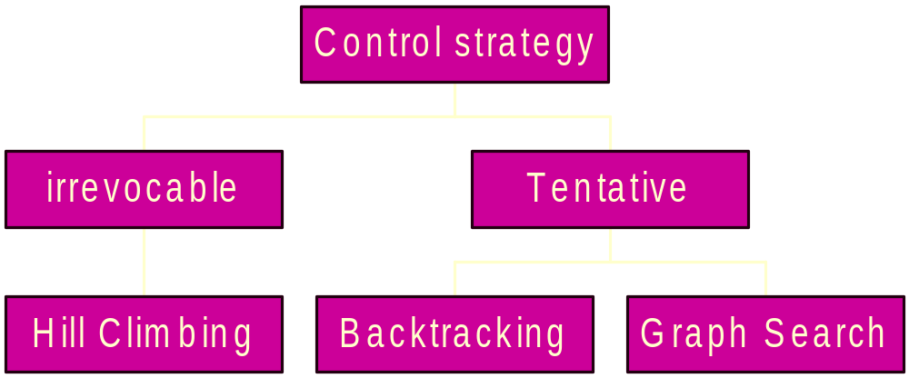

Slide 31
Hill Climbing
Variant of Generate and Test
Steps involved:
1. Generate a proposed solution
2. If it is a goal, stop
3. If not, generate a set of new proposed solutions
4. Evaluate each with the heuristic
5. Select the best and repeat the process
A simple heuristic is used to estimate how close a given state is to the goal state

Slide 32
8 Puzzle
Problem :
Data Base : 3x3 Matrix or a Vector with length 9.
Rules : Precondition :
  Move Blank Left Not at extreme left
  Move Blank Right Not at extreme right
  Move Blank Up Not at top row
  Move Blank Down Not at bottom row
8
7
5
1
2
3
4
1
3
8
4
6
2
7
6
5

Slide 33
8 Puzzle cont.
Initial State :
Move Blank Up
Move Blank Up
Move Blank Left
Move Blank Down
Move Blank Right
Goal State :
2
8
3
1
6
4
7
5
1
2
3
8
4
7
6
5

Slide 34
Hill Climbing
Use heuristic function as measure of how many tiles are out of place.
Choose rule giving best increase in function.

Slide 35
Example
-4
-3
-3
2
8
3
U
2
8
3
U
2
3
L
1
6
4
1
4
1
8
4
7
5
7
6
5
7
6
5
-2
-1
0
2
3
D
1
2
3
R
1
2
3
1
8
4
8
4
8
4
7
6
5
7
6
5
7
6
5

Slide 36
Hill Climbing cont.
Problems :
Local Maxima – Initial Goal
Plateaus.
Ridge.
1
2
5
1
2
3
7
4
7
4
8
6
3
8
6
5

Slide 37
Problems which can occur
Local maximas
or foothills:
Ridge:
Plateau:
z
y
y
x
x
z
y
y
x
x
z
y
y
x
x

Slide 38
Backtracking

Slide 39
Backtracking in Decision Trees
empty board
Q
place 1st queen
Q
Q
Q
place 2nd queen
Q
Q
Q
Q
Q
Q
place 3rd queen
Q
Q
Q
Q
Q
place 4th queen
Q
Q
Q

Slide 40
Search Tree
R1
R2
R1
R3
R3
R1
R5
R1
R2
R3
R5
R2
R3
R2
R1
R5
goal

Slide 41
Control
Data Base (state)
R5?
Data Base
R2?
R3?
Data Base
Data Base

Slide 42
Depth First Search

Slide 43
Breadth First cont.

Slide 44
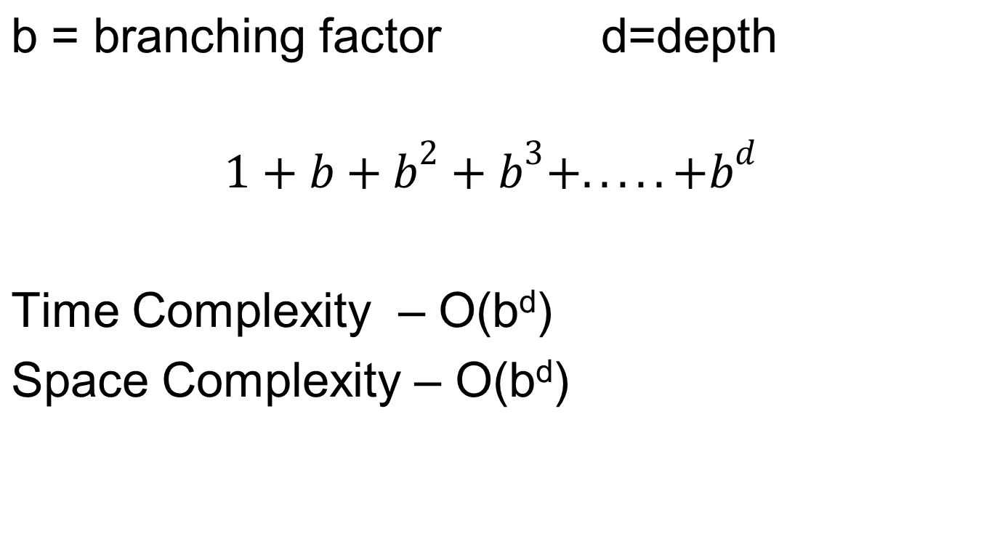
Breadth First

Slide 45
Breadth-First vs. Depth-First
Uninformed breadth-first search:
Requires the construction and memorization of almost the complete search tree.
  Space complexity for search depth d is O(b^{d}).
Is guaranteed to find the shortest path to a solution.
Uninformed depth-first search:
Requires the memorization of only the current path and the branches from this path that were already visited.
  Space complexity for search depth d is O(d).
May search unnecessarily deep for a shallow goal.

Slide 46
Iterative Deepening
Iterative deepening is an interesting combination of breadth-first and depth-first strategies:
Space complexity for search depth d is O(d).
Is guaranteed to find the shortest path to a solution
without searching unnecessarily deep.
How does it work?
The idea is to successively apply depth-first searches with increasing depth bounds (maximum search depth).

Slide 47
Iterative Deepening
maximum search depth = 1

Slide 48
Iterative Deepening
maximum search depth = 2

Slide 49
Iterative Deepening
maximum search depth = 3

Slide 50
Iterative Deepening
maximum search depth = 4

Slide 51
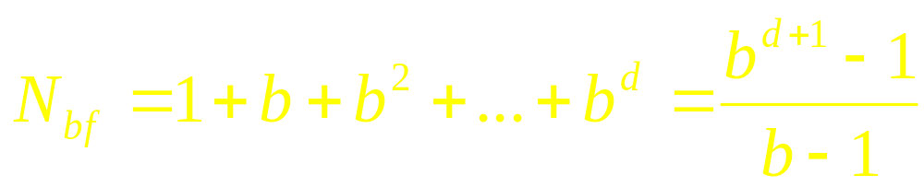
Iterative Deepening
But it seems that the time complexity of iterative deepening is much higher than that of breadth-first search!
Well, if we have a branching factor b and the shallowest goal at depth d, then the worst-case number of nodes to be expanded by breadth-first is:

Slide 52
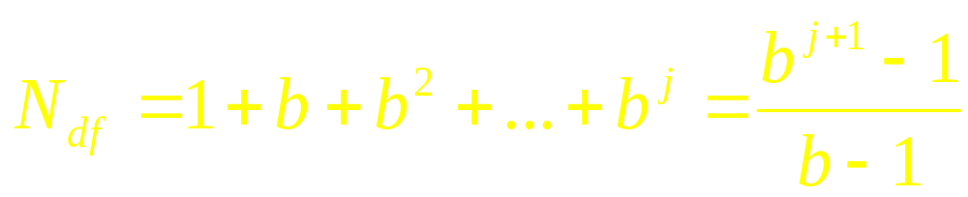
Iterative Deepening
In order to determine the number of nodes expanded by iterative deepening, we have to look at depth-first search.
What is the worst-case number of nodes expanded by depth-first search for a branching factor b and a maximum search level j ?

Slide 53
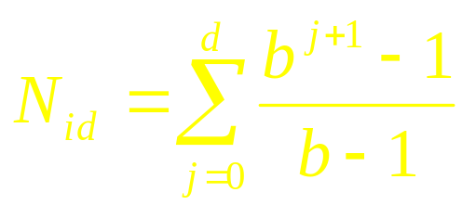
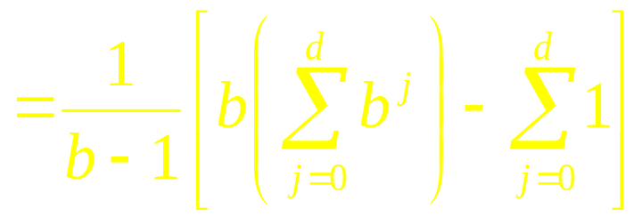
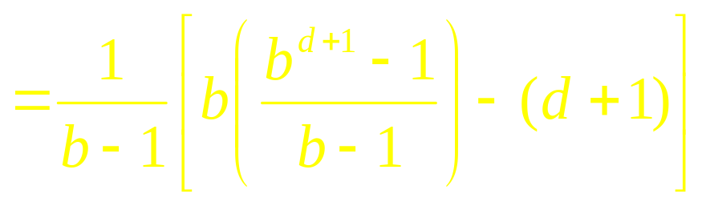
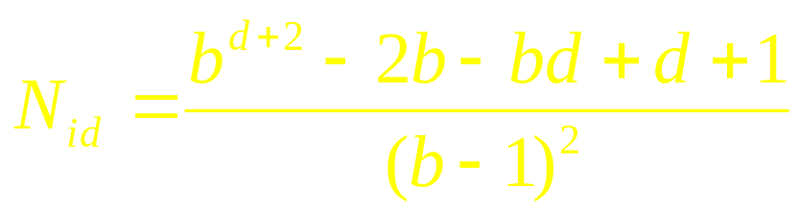
Iterative Deepening
Therefore, the worst-case number of nodes expanded by iterative deepening from depth 0 to depth d is:

Slide 54
Iterative Deepening
Let us now compare the numbers for breadth-first search and iterative deepening:
For large d, you see that N_{id}/N_{bf} approaches b/(b – 1), which in turn approaches 1 for large b.
So for big trees (large b and d), iterative deepening does not expand many more nodes than does depth-first search (about 11% for b = 10 and large d).

Slide 55
Tradeoff between space and time
Iterative deepening
  Performs DFS repeatedly using increasing depth bounds
  Works in O(b^{d}) time and O(bd) space
Bi-directional search
  Possible only if the operators are reversible
  Works in O(b^{d/2}) time and O(b^{d/2}) space

Slide 56
Some more general problems
Search for Optimization:
  Given: [S, s, O, G] where
    S is the (implicitly specified) set of states
    s is the start state
    O is the set of state transition operators each having some cost
    G is the set of goal states each having some cost
  To find:
    A minimum cost sequence of transitions to a goal state
    A sequence of transitions to the minimum cost goal
    A minimum cost sequence of transitions to a min cost goal
  Are all these fundamentally different problems?

Slide 57
Principle of Optimality for Dynamic Programming
Any subsequence of an optimal sequence of transitions is also optimal.
  This gives us the handle to grow an optimal partial solution into an optimal solution
  Intermediate states (in a path from a start state to a goal state) may represent partial solutions
  This does not hold for the longest path problem

Slide 58
Uniform Cost Search
This algorithm assumes that all operators have a cost:
Initialize: Set OPEN = {s}, CLOSED = { } Set C(s) = 0
Fail: If OPEN = { }, then terminate with failure
Select: Select the minimum cost state, n, from OPEN
Save n in CLOSED
Terminate: If n ∈ G, terminate with success
Expand: Generate the successors of n using O.
    For each successor, m:
    If m ∉[OPEN ∪ CLOSED]
    Set C(m) = C(n) + C(n,m) and insert m in OPEN
    If m ∈ [OPEN ∪ CLOSED]
    Set C(m) = min {C(m), C(n) + C(n,m)}
    If C(m) has decreased and m ∈ CLOSED, move it to OPEN
Loop: Go To Step 2.

Slide 59
Searching with costs
If all operator costs are positive, then the algorithm finds the minimum cost sequence of transitions to a goal.
  No state comes back to OPEN from CLOSED
If operators have unit cost, then this is same as BFS
What happens if negative operator costs are allowed?

Slide 60
Branch-and-bound
Initialize: Set OPEN = {s}, CLOSED = { }. Set C(s) = 0, C* = ∞
Terminate: If OPEN = { }, then return C*
Select: Select a state, n, from OPEN and save it in CLOSED
Terminate: If n ∈ G and C(n) < C*,
then Set C* = C(n) and Go To Step 2.
Expand: If C(n) < C* generate the successors of n
    For each successor, m:
    If m ∉[OPEN ∪ CLOSED]
    Set C(m) = C(n) + C(n,m) and insert m in OPEN
    If m ∈ [OPEN ∪ CLOSED]
    Set C(m) = min {C(m), C(n) + C(n,m)}
    If C(m) has decreased and m ∈ CLOSED, move it to OPEN
Loop: Go To Step 2.

Slide 61
The notion of heuristics
Heuristics use domain specific knowledge to estimate the quality or potential of partial solutions
Examples:
  Manhattan distance heuristic for 8 puzzle
  Minimum Spanning Tree heuristic for TSP
  Heuristics are fundamental to chess programs

Slide 62
The informed search problem
Problem definition:
  Given: [S, s, O, G] where
    S is the (implicitly specified) set of states
    s is the start state
    O is the set of state transition operators each having some cost
    G is the set of goal states
    h( ) is a heuristic function estimating the distance to a goal
  To find:
    A minimum cost sequence of transitions to a goal state

Slide 63
Greedy Best-First Search
f (n) = h (n)
Greedy best-first search may switch its strategy mid-search. For example, it may go depth-first for awhile, but then return to the shallow parts of the tree.

Slide 64
Greedy Example
In the map domain, h(n) could be the straight line distance from a city to Bucharest
Greedy search expands the node that currently appears to be closest to the goal

Slide 65
Go from Arad to Bucharest
380
Oradea
Neamt
71
151
374
253
176
Iasi
Zerind
75
Sibiu
Fagaras
Arad
99
140
Vaslui
366
80
211
118
193
Timisoara
Rimnicu Vilcea
Urziceni
Hirsova
329
97
111
Lugoj
Pitesti
244
101
85
70
146
241
Mehadia
Bucharest
75
138
90
0
Eforie
Dobreta
120
Craiova
Giurgiu
160

Slide 66
Greedy Example
Arad 366
Zerind 374
Sibiu 253
Timisoara 329
Arad 366
Oradea 380
Fagaras 178
Rimniciu 193
Sibiu 253
Bucharest 0

Slide 67
Greedy Search
Complete?
  No
Optimal?
  No
Time and Space?
  It depends

Slide 68
Algorithm A*
Initialize: Set OPEN = {s}, CLOSED = { }, g(s) = 0, f(s) = h(s)
Fail: If OPEN = { }, then terminate with failure
Select: Select the minimum cost state, n, from OPEN
Save n in CLOSED
Terminate: If n ∈ G, terminate with success, return f(n)
Expand: Generate the successors of n using O.
For each successor, m,
If m ∉[OPEN ∪ CLOSED]
    Set g(m) = g(n) + C(n,m)
    Set f(m) = g(m) + h(m) and insert m in OPEN
  If m ∈ [OPEN ∪ CLOSED]
    Set g(m) = min { g(m), g(n) + C(n,m) } and f(m) = g(m) + h(m)
    If f(m) has decreased and m ∈ CLOSED, move it to OPEN
Loop: Go To Step 2.

Slide 69
Example
2
h*
b 8
c 10
d 8
e 5
f 5
g 4
h 2
i -
a
d
4
1
3
7
c
3
b
f
4
5
6
2
3
e
1
5
h
g
5
4
i

Slide 70
2
a
d
4
1
3
7
a
c
3
b
f
4
5
6
2
3
e
1
5
h
h*
b 8
c 10
d 8
e 5
f 5
g 4
h 2
i -
g
5
4
i

Slide 71
2
a
d
4
1
3
7
a
c
3
b
f
b
c
d
4
5
6
2
3
e
1
5
h
h
b 8
c 10
d 8
e 5
f 5
g 4
h 2
i -
g
5
4
i

Slide 72
2
a
d
4
1
3
7
a
c
3
3
4
2
b
f
b
c
d
4
5
6
2
3
e
1
5
h
h
b 8
c 10
d 8
e 5
f 5
g 4
h 2
i -
g
5
4
i

Slide 73
2
a
d
4
1
3
7
a
c
3
3
4
2
b
f
11
b
c
14
d
10
4
5
6
2
3
e
1
5
h
h*
b 8
c 10
d 8
e 5
f 5
g 4
h 2
i -
g
5
4
i

Slide 74
2
a
d
4
1
3
7
a
c
3
3
4
2
b
f
11
b
c
14
d
10
4
5
6
1
7
2
3
e
13
c
f
14
1
5
h
h*
b 8
c 10
d 8
e 5
f 5
g 4
h 2
i -
g
5
4
i

Slide 75
2
a
d
4
1
3
7
a
c
3
3
4
2
b
f
11
b
c
14
d
10
4
5
6
1
7
2
3
e
13
c
f
14
1
5
h
h
b 8
c 10
d 8
e 5
f 5
g 4
h 2
i -
g
5
4
i

Slide 76
2
a
d
4
1
3
7
a
c
3
3
4
2
b
f
11
b
c
14
d
10
4
5
6
3
6
1
7
2
3
e
16
c
e
14
13
c
f
14
1
5
h
h
b 8
c 10
d 8
e 5
f 5
g 4
h 2
i -
g
5
4
i

Slide 77
2
a
d
4
1
3
7
a
c
3
3
4
2
b
f
11
b
c
14
d
10
4
5
6
3
6
1
7
2
3
e
16
c
e
14
13
c
f
14
1
5
h
h*
b 8
c 10
d 8
e 5
f 5
g 4
h 2
i -
g
5
4
i

Slide 78
2
a
d
4
1
3
7
a
c
3
3
4
2
b
f
11
b
c
14
d
10
4
5
6
3
6
1
7
2
3
e
16
c
e
14
13
c
f
14
1
3
5
5
h
4
h*
b 8
c 10
d 8
e 5
f 5
g 4
h 2
i -
g
14
b
e
12
g
12
5
4
i

Slide 79
2
a
d
4
1
3
7
a
c
3
3
4
2
b
f
11
b
c
14
d
10
4
5
6
3
6
1
7
2
3
e
16
c
e
14
13
c
f
14
1
3
5
5
h
4
h*
b 8
c 10
d 8
e 5
f 5
g 4
h 2
i -
g
14
b
e
12
g
12
5
4
i

Slide 80
2
a
d
4
1
3
7
a
c
3
3
4
2
b
f
11
b
c
14
d
10
4
5
6
3
6
1
7
2
3
e
16
c
e
14
13
c
f
14
1
3
5
5
h
4
h*
b 8
c 10
d 8
e 5
f 5
g 4
h 2
i -
g
14
b
e
12
g
12
5
4
i

Slide 81
2
a
d
4
1
3
7
a
c
3
3
4
2
b
f
11
b
c
14
d
10
4
5
6
3
6
1
7
2
3
e
16
c
e
14
13
c
f
14
1
3
5
5
h
4
h*
b 8
c 10
d 8
e 5
f 5
g 4
h 2
i -
g
14
b
e
12
g
12
5
4
6
4
1
5
i
2
5
21
b
g
15
14
e
f
15
h
15
i
13

Slide 82
2
a
d
4
1
3
7
a
c
3
3
4
2
b
f
11
b
c
14
d
10
4
5
6
3
6
1
7
2
3
e
16
c
e
14
13
c
f
14
1
3
5
5
h
4
h*
b 8
c 10
d 8
e 5
f 5
g 4
h 2
i -
g
14
b
e
12
g
12
5
4
6
4
1
5
i
2
5
21
b
g
15
14
e
f
15
h
15
i
13

Slide 83
2
a
d
4
1
3
7
a
c
3
3
4
2
b
f
11
b
c
14
d
10
4
5
6
3
6
1
7
2
3
e
16
c
e
14
13
c
f
14
1
3
5
5
h
4
h*
b 8
c 10
d 8
e 5
f 5
g 4
h 2
i -
g
14
b
e
12
g
12
5
4
6
4
1
5
i
2
5
21
b
g
15
14
e
f
15
h
15
i
13

Slide 84
2
a
d
4
1
3
7
a
c
3
3
4
2
b
f
11
b
c
14
d
10
4
5
6
3
6
1
7
2
3
e
16
c
e
14
13
c
f
14
1
3
5
5
h
4
h*
b 8
c 10
d 8
e 5
f 5
g 4
h 2
i -
g
14
b
e
12
g
12
5
4
6
4
1
5
i
2
5
21
b
g
15
14
e
f
15
h
15
i
13

Slide 85
2
a
d
4
1
3
7
a
c
3
3
4
2
b
f
11
b
c
14
d
10
4
5
6
3
6
1
7
2
3
e
16
c
e
14
13
c
f
14
1
3
5
5
h
4
h*
b 8
c 10
d 8
e 5
f 5
g 4
h 2
i -
g
14
b
e
12
g
12
5
4
6
4
1
5
i
2
5
21
b
g
15
14
e
f
15
h
15
i
13

Slide 86
2
a
d
4
1
3
7
a
c
3
3
4
2
b
f
11
b
c
14
d
10
4
5
6
3
6
1
7
2
3
e
16
c
e
14
13
c
f
14
1
3
5
5
h
4
h
b 8
c 10
d 8
e 5
f 5
g 4
h 2
i -
g
14
b
e
12
g
12
5
4
6
4
1
5
i
2
5
21
b
g
15
14
e
f
15
h
15
i
13

Slide 87
Finding Optimal Solutions
Input: A random solvable initial state
Output: A shortest sequence of moves that maps the initial state to the goal state
Generalized sliding-tile puzzle is NP Complete (Ratner and Warmuth, 1986)
People can’t find optimal solutions.
Progress measured by size of problems that can be solved optimally.

Slide 88
Rubik’s Cube

Slide 89
Sizes of Problem Spaces
Problem
Nodes
Brute-Force Search Time (10 million nodes/second)
8 Puzzle: 10⁵ .01 seconds
2³ Rubik’s Cube: 10⁶ .2 seconds
15 Puzzle: 10¹³ 6 days
3³ Rubik’s Cube: 10¹⁹ 68,000 years
24 Puzzle: 10²⁵ 12 billion years

Slide 90
Optimality of A*
Node evaluation function: f(x) = g(x) +h(x)
Here g(x) is best possible estimate of g*(x) the minimal cost to get to x from s.
h(x) is estimate of h*(x) the minimal cost to get to any goal from x.
  Choose h(x) such that h(x) <= h*(x) (admissible heuristic)
  An admissible heuristic is one that never overestimates the cost of the minimum cost path from a node to the goal node

Slide 91
In such a circumstance A* returns optimal path.
Examples:
h(x) = 0
For 8 puzzle h(x) = number of tiles in wrong position
For 8 puzzle h(x) = sum of distances each tile is from home

Slide 92
Optimality of A*
Theorem:
A* finds an optimal solution if the heuristic h(n) is admissible.
Informed Search and Exploration

Slide 93
Proof: Optimality of A*
assumptions:
  suboptimal goal node G₂ appears on fringe
  cost of optimal solution is C*
f(G₂) = g(G₂) + h(G₂) = g(G₂) > C*
consider fringe node n (or leading node n whose all predecessors along the optimal path are in closed and the node n is in open) on path to optimal solution:
f(n) = g(n) + h(n) ≤ C*
f(n) ≤ C* < f(G₂)
Informed Search and Exploration
Notes:
Assumptions:
For G₂ to be returned as the solution it needs to be expanded before any other solution, i.e. its f-value must be the lowest on the fringe;
Calculation:
definition of f(G₂) = g(G₂) + h(G₂) for A*;
since G₂ is a goal node h(G₂) = 0;
since G₂ is suboptimal f(G₂) > C*;
Fringe node n:
such a node must exist;
f(n) = g(n) + h(n) by definition;
f(n) ≤ C* because n is on a path to an optimal solution and h is admissible, i.e. does not overestimate the distance to the goal;
Thus: nodes on an optimal path (incl. the optimal solution) will always be expanded before any suboptimal goal nodes that may be on the fringe;
A* using tree search is optimal if the heuristic h(n) is admissible;

Slide 94
Monotone Heuristics
A heuristic h(n) is monotone if, for every node n and every child n’ of n, the estimated cost of reaching the goal from n is no greater than the arc cost c(n, n’) plus the estimated cost of reaching the goal from n’:
h(n) ≤ c(n, n’) + h(n’)
root
n
c(n, n’)
n’
h(n)
h(n’)
goal
Informed Search and Exploration
Notes:
Drawing: a heuristic is consistent if the triangle inequality holds;
Note: every consistent heuristic is also admissible, but not vice versa;
Example: h_{SLD} is consistent; proof: triangle inequality holds for 2D space;

Slide 95
Optimality of A*
Theorem:
A* does not expand any node more than once if the heuristic h(n) is monotone.
Informed Search and Exploration

Slide 96
Proof: Optimality of A*
if h(n) is monotone, then the f-values along any path are non-decreasing:
f(n’) = g(n’) + h(n’)
= g(n) + c(n, n’) + h(n’)
≥ g(n) + h(n) = f(n)
the sequence of nodes expanded by A* is in non-decreasing order of their f-values
the first goal node selected for expansion must be optimal
Informed Search and Exploration
Notes:
Calculation:
f(n’) = g(n’) + h(n’) by definition of f(n’);
g(n’) = g(n) + c(n, a, n’);
c(n, a, n’) + h(n’) ≥ h(n);
Hence f(n’) ≥ f(n);
A* always expands the node from the fringe with the lowest f-value; nodes generated later must have higher f-values;
A* using graph search is optimal if the heuristic h(n) is consistent;

Slide 97
A* (Best-First) Search: Evaluation
Completeness | yes
Optimality | yes
Time Complexity | O(b^{d})
Space Complexity | O(b^{d})
Informed Search and Exploration
Notes:
Completeness: see contours;
Optimality: see proof;
Time complexity: C* = cost of optimal solution; l = length of longest path from start node to a node within the C* contour;
Space complexity: like time complexity;
Overall:
Still exponential time and space complexity;
But: optimally efficient for a given heuristic;

Slide 98
A*: Optimally Efficient
A* is optimally efficient for a given admissible heuristic function,
no other optimal algorithm is guaranteed to expand fewer surely-expandable nodes (i.e. nodes n with f(n) < C*) than A*.
any algorithm that does not expand all nodes with f(n) < C* runs the risk of missing the optimal solution
Informed Search and Exploration
Notes:
Efficiency can still be increased with a different, more accurate heuristic for a given problem.
Suppose there is a node with f(n) < C* that is not expanded before a goal node, then there could be a path of cost with f(n) < C* through that node which would be better than the goal node found.

Slide 99
Pruning
What gives A* its power?
pruning
  eliminate possibilities from consideration without having to examine them
  ignoring sub-trees of which we know that they do not lead to the optimal goal node
Informed Search and Exploration
Notes:
Pruning: knowing without exploring, of course;
Pruning often comes at a cost: reason about what to do; trade-off;
Pruning is important for many areas of AI;

Slide 100
A* and Exponential Space
A* has worst case time and space complexity of O(b^{d}), where d is the search depth
exponential growth of the fringe is normal
  exponential time complexity may be acceptable
  exponential space complexity will exhaust any computer’s resources all too quickly
Informed Search and Exploration

Slide 101
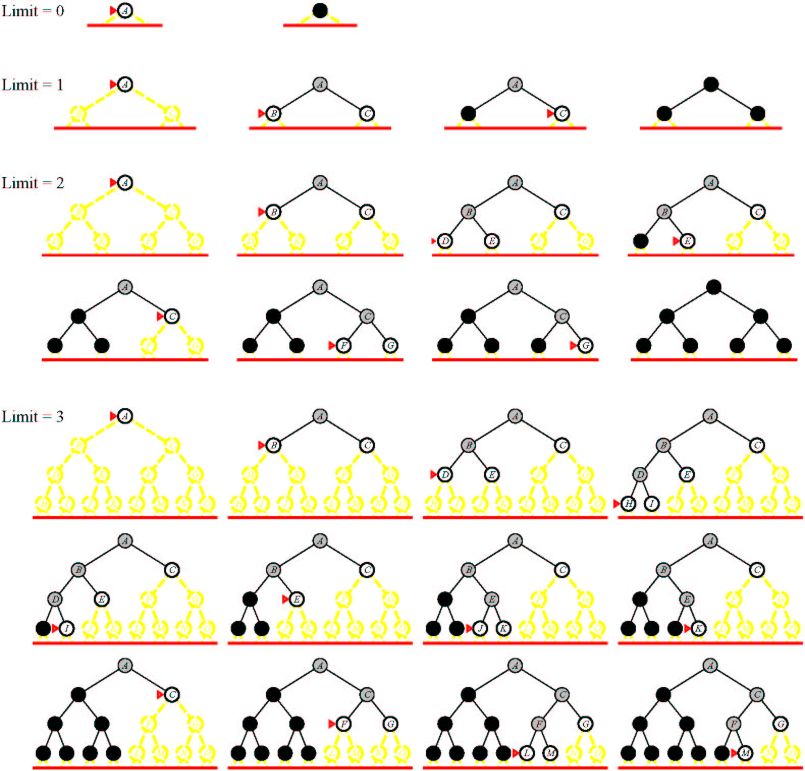
DFID (Depth First Iterative Deepening)

Slide 102
IDA*
Combine A* and iterative deepening
f is the estimate of total path cost for start to goal
IDA*:
  Impose a limit on f
  Use DFS to search within the f limit
  Iteratively relax the limit
Greatly reduces memory usage
Can repeat far too much work, and so be slow

Slide 103
Memory-Bounded Search: IDA*
same idea as iterative deepening: sequence of depth-first searches to cut-off
use f-cost (g+h) as cut-off
at each iteration, the cut-off value is the smallest f-cost of any node that exceeded the cut-off on the previous iteration
Informed Search and Exploration
Notes:
IDA* stands for Iterative Deepening A*;
Uses only linear space;
Works reasonably well for problems with unit cost (each step costs the same);
Not practical for problems with real-valued step cost;

Slide 104
IDA*
Procedure IDA*:
Let z, z’ be global variables.
Set z: = h(s), where s is the start node. Set z’ := ∞.
Do the following steps repeatedly:
Set P: = the path containing only s ;
Call Depth-First(P)
Set z:= z’.

Slide 105
IDA*(Contd.)
Procedure Depth-First(P) :
Set f : = cost(P) + h(last(P)).
If f>z, then set z’ : = min(z’, f).
Otherwise, if last(P) is a goal node, then exit from IDA*, returning P.
Otherwise, do the following steps for every child n of last(P)
Call Depth-First(P’)

Slide 106
A* has three advantages over IDA* that allows it to build smaller search trees:
IDA*cannot detect repeated states, whereas A* benefits from the information contained in the Open and Closed lists to avoid repeating search effort.
IDA*’s iterative deepening results in the search repeatedly visiting states as it reconstructs the frontier(leaf nodes) of the search. A*’s Open List maintains the search frontier.
IDA* uses a left-to-right traversal of the search frontier. A* maintains the frontier in sorted order, expanding nodes in a best-first manner.
Pathfinding Algorithms
Zhongjun Zhang

Slide 107
Example of A*
S
0
2
3
m₁
m₂
4
1
3
3
4
m₃
1
2
1
2
m₅
m₄
2
1
1
1
3
m₆
r
2

Slide 108
Steps of A* :
Step OPEN CLOSED Selected
1 S⁰⁺⁰ Null S
2 m₁²⁺⁴ , m₂³⁺³ S⁰⁺⁰ m₁
3 m₂³⁺³ , m₃⁵⁺⁰ , m₄⁶⁺¹ S⁰⁺⁰ , m₁²⁺⁴ m₃
4 m₅⁷⁺² , m₂³⁺³ , m₄⁶⁺¹ S⁰⁺⁰ , m₁²⁺⁴ , m₃⁵⁺⁰ m₂
5 m₃⁴⁺⁰ m₄⁶⁺¹ , m₅⁴⁺² S⁰⁺⁰ , m₁²⁺⁴ , m₂³⁺³ m₃
6 m₄⁵⁺¹ , m₅⁴⁺² S⁰⁺⁰ , m₁²⁺⁴ , m₂³⁺³ , m₃⁴⁺⁰ m₄
7 m₆⁶⁺², m₅⁴⁺² r^{6+0,} S⁰⁺⁰ , m₁²⁺⁴ , m₂³⁺³ , m₃⁴⁺² ,
m₄⁵⁺¹ r
8 m₆⁶⁺² , m₅⁴⁺² S⁰⁺⁰ , m₁²⁺⁴ , m₂^{3+3,} m₃⁴⁺² ,
m₄⁵⁺¹, r terminate

Slide 109
THANK YOU

